Slide 1


Job Market Skills (FL501): Getting a Job in the Future of the IT Sector
CV Writing Workshop
Lesson 2: 17/02/23
CV Writing Workshop

Slide 2
CV Writing Workshop
Date | Lesson | Theme | Learning Outcomes/Objectives | Theme/Activities/Skills targeted | Resources
17/02/23 | 2 | Getting a job in the future of the IT/Engineering Sector CV writing workshop | After completing this lesson students should be able to:- • Understand that a CV should highlight the skills, personal qualities, qualifications, interests, and experience that a potential employer is looking for • Create a draft CV | •Interactive Worksheet: What makes a Winning CV •Teacher led discussion on advantages of a functional and chronological CV •Activity: Play the Boss: students look at a number of CVs and identify the successful ones. They give their reasons for picking or rejecting the CVs. | play-the-boss-student | work |Barclays Life Skills How to CREATE the PERFECT Software Developer RESUME/CV - Bing video

Slide 3
CV Writing Workshop
Introduction
You might have written a CV when you applied for previous jobs or internships or you may never have written a CV before.
Either way, the Curriculum Vitae (CV, meaning ‘course of life’ in Latin) is likely to be your first opportunity to tell potential employers why you’re the right person for the job. So, it’s worth spending the time and energy to make it as impactful as possible for every application.

Slide 4
CV Writing Workshop
What is a CV?
The CV is a document that helps one demonstrate their skills, interests and experience to potential employers.
Class Activity
What do you think makes a CV stand out? Use the interactive worksheet to give your answers

Slide 5
CV Writing Workshop
What should go on my CV?
Your name and contact details
Skills and personality traits that show you are a fit for the job description advertised
Your education and qualifications
Past jobs and work experience
Interests that show the ‘whole person’
Referees – people who can back up what you say on your CV
Writing a Personal Profile.
In this part, you need to highlight your best skills and personal qualities. Think about whether your skills can transfer to the field of work as learnt in Lesson 2.

Slide 6
CV Writing Workshop
How Should I Organise my CV?
The information on your CV should be organised in either:-
(i) a Chronological (starting with the most recent) or
(ii ) a functional manner (skill based)
Chronological Format
Starts with the most recent
Highlights your qualifications and jobs
Shows your experience
Functional or skills-based
Highlights your skills and qualities
Shows your ability

Slide 7
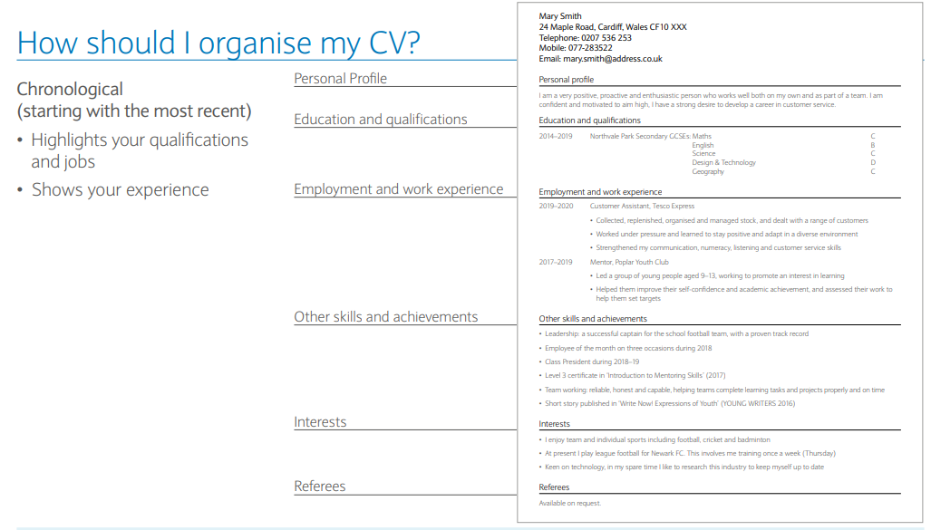
CV Writing Workshop: Chronological CV
How Should I Organise my CV?
The information on your CV should be organised in either:-
(i) a Chronological (starting with the most recent) or
(ii ) a functional manner (skill based)
Chronological Format
Starts with the most recent
Highlights your qualifications and jobs
Shows your experience
Functional or skills-based

Slide 8
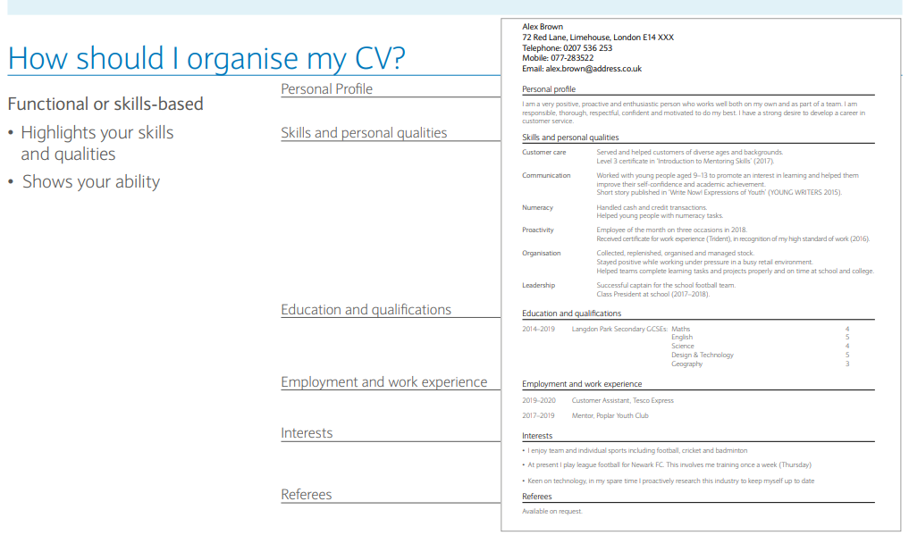
CV Writing Workshop: Functional CV
How Should I Organise my CV?
The information on your CV should be organised in either:-
(i) a Chronological (starting with the most recent) or
(ii ) a functional manner (skill based)
Chronological Format
Starts with the most recent
Highlights your qualifications and jobs
Shows your experience
Functional or skills-based

Slide 9
CV Writing Workshop
Discussion
Look at the two samples of CVs (chronological and functional).
How do they present the same information in different ways?
What does each one highlight?
What are the pros and cons of each?
Game - Activity: Play the Boss:
play-the-boss-student | work |Barclays Life Skills
Against the clock, play the boss and choose the CVs you think should be picked for the job.
Give the correct CVs a thumbs up and the CVs with mistakes a thumbs down.
See how well you did by comparing your choices to the boss.

Slide 10
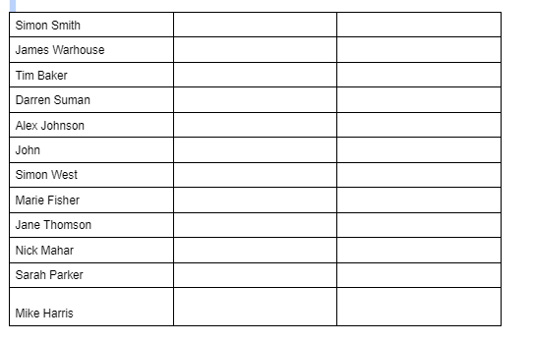
CV Writing Workshop: Playing the Boss - Yea or Nay?

Slide 11
CV Writing Workshop
Discussion
What did you find most challenging about reviewing the CVs?
What did you learn about the way an employer may review your CV?
What three things will you consider when writing or fine tuning your CV?

Slide 12
CV Writing Workshop
Discussion
What did you find most challenging about reviewing the CVs?
What did you learn about the way an employer may review your CV?
What three things will you consider when writing or fine tuning your CV?

Slide 13
CV Writing Workshop
Listening Activity
Listen to the following video on how to Create the Perfect Software developer CV
https://www.bing.com/videos/search?q

Slide 14
Discussion: Current Trends in the IT Job Market
Top IT Skills That Are in Demand in 2022 | CompTIA
2022 tech layoffs: The companies that have cut jobs this year (cnbc.com) Tech layoffs bleed into 2023. Why companies are firing workers (usatoday.com) 10 Hot Topics in HR That Will Shape 2022 (untapped.io)

Slide 15

Coffee Break

